Slide 1
Assignment
Topic: Extreme Programming

Slide 2
Introduction
This assignment focuses on using Extreme Programming (XP) techniques to enhance Warner & Spencer's sales strategy. The objective is to assess and implement innovative
methods that boost product sales, increase market reach, and improve customer satisfaction. XP, known for its iterative, collaborative, and customer-focused approach, will be applied to create agile solutions and foster continuous improvements in sales tactics. Essential practices like pair programming, ongoing feedback, and adaptive planning will be explored to make sales processes more efficient and increase product success rates..

Slide 3





Objectives
Analysis Phase
Strategy Development
Implementation Plan
What is Extreme Programming (XP)?
Basic Principles of Extreme Programming
Values of Extreme Programming (XP)
Good Practices in Extreme Programming
Applications of Extreme Programming (XP)
Advantages of Extreme Programming (XP
Conclusion
Life Cycle of Extreme Programming (XP)

Slide 4

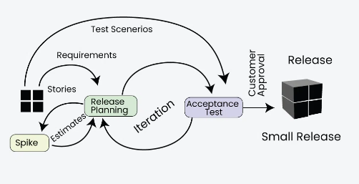
Introduction
What is Extreme Programming (XP)?
Extreme Programming (XP) is an Agile software development
methodology that focuses on delivering high-quality software through frequent and continuous feedback, collaboration, and adaptation. XP emphasizes a close working relationship between the development team, the customer, and stakeholders, with an emphasis on rapid, iterative development and deployment.

Slide 5
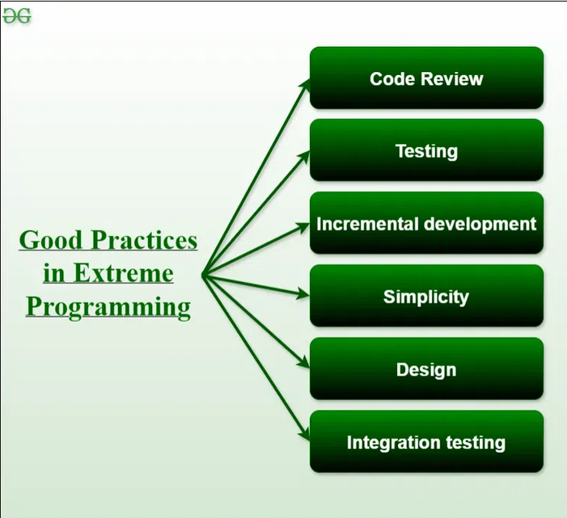
Good Practices in Extreme Programming
Code Review: Code review detects and corrects errors efficiently. It suggests pair programming as coding and reviewing of written code carried out by a pair of programmers who switch their work between them every hour.
Testing: Testing code helps to remove errors and improves its reliability. XP suggests test-driven development (TDD) to continually write and execute test cases. In the TDD approach, test cases are written even before any code is written.
Simplicity: Simplicity makes it easier to develop good-quality code as well as to test and debug it.

Slide 6
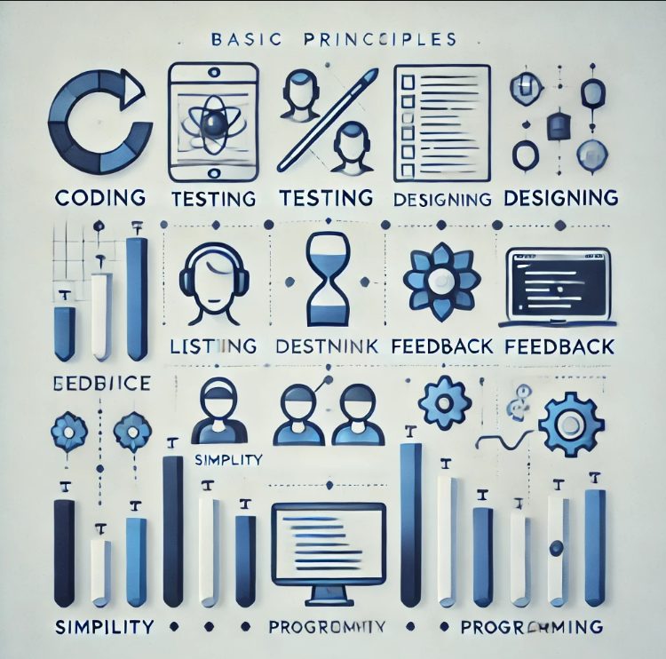
Basic Principles of Extreme programming
Coding: The concept of coding which is used in the XP model is slightly different from traditional coding. Here, the coding activity includes drawing diagrams (modeling) that will be transformed into code, scripting a web-based system, and choosing among several alternative solutions.
Testing: The XP model gives high importance to testing and considers it to be the primary factor in developing fault-free software.
Feedback: One of the most important aspects of the XP model is to gain feedback to understand the exact customer needs. Frequent contact with the customer makes the development effective.
Designing: Without a proper design, a system implementation becomes too complex, and very difficult to understand the solution, thus making maintenance expensive. A good design results elimination of complex dependencies within a system. So, effective use of suitable design is emphasized.

Slide 7
Applications of Extreme Programming (XP)
Small projects: The XP model is very useful in small projects consisting of small teams as face-to-face meeting is easier to achieve.
Projects involving new technology or Research projects: This type of project faces changing requirements rapidly and technical problems. So XP model is used to complete this type of project.
Web development projects: The XP model is well-suited for web development projects as the development process is iterative and requires frequent testing to ensure the system meets the requirements.
Collaborative projects: The XP model is useful for collaborative projects that require close collaboration between the development team and the customer.
Projects with tight deadlines: The XP model can be used in projects that have a tight deadline, as it emphasizes simplicity and iterative development.
Projects with rapidly changing requirements: The XP model is designed to handle rapidly changing requirements, making it suitable for projects where requirements may change frequently.

Slide 8
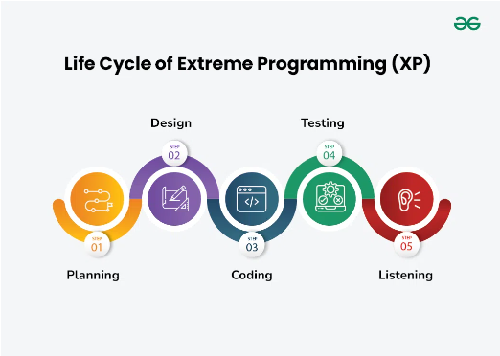
Planning: The first stage of Extreme Programming is planning. During this phase, clients define their needs in concise descriptions known as user stories. The team calculates the effort required for each story and schedules releases according to priority and effort.
Design: The team creates only the essential design needed for current user stories, using a common analogy or story to help everyone understand the overall system architecture and keep the design straightforward and clear.
Coding: Extreme Programming (XP) promotes pair programming i.e. wo developers work together at one workstation, enhancing code quality and knowledge sharing. They write tests before coding to ensure functionality from the start (TDD), and frequently integrate their code into a shared repository with automated tests to catch issues early.
Testing: Extreme Programming (XP) gives more importance to testing that consist of both unit tests and acceptance test. Unit tests, which are automated, check if specific work correctly. Acceptance tests, conducted by customers, ensure that the overall system meets initial requirements. This continuous testing ensures the software’s quality and alignment with customer needs.
Listening: In the listening phase regular feedback from customers to ensure the product meets their needs and to adapt to any changes.
Life Cycle of
Extreme Programming (XP)

Slide 9
Conclusion
In conclusion, implementing a well-researched and innovative sales strategy will not only drive immediate sales growth but also create a sustainable framework for long-term success, ensuring continued development and market leadership.

Slide 10
Thank you

